Slide 1
CICS, REST, JSON, etc.
IBM Advanced Technology Group
Steve Fowlkes – fowlkes@us.ibm.com
Leigh Compton – lcompton@us.ibm.com

Slide 2
Abstract
This presentation provides an overview of how CICS applications can integrate into your environment using REST and JSON technologies.

Slide 3
Trademarks
The following terms are trademarks of the International Business Machines Corporation or/and Lotus Development Corporation in the United States, other countries, or both:
Redbooks(logo)™, AIX®, alphaWorks®, CICS®, DB2®, IBM®, IMS™, Informix®, MQSeries®, VisualAge®, WebSphere®
The following terms are trademarks of other companies:
Microsoft, Windows, Windows NT, and the Windows logo are trademarks of Microsoft Corporation.
Java and all Java-based trademarks and logos are trademarks or registered trademarks of Oracle, Inc.
CORBA, CORBAServices, and IIOP are trademarks of the Object Management Group, Inc.
UNIX is a registered trademark of The Open Group in the United States and other countries.
Other company, product, and service names may be trademarks or service marks of others.

Slide 4
Notices
This information was developed for products and services offered in the U.S.A. IBM may not offer the products, services, or features discussed in this presentation in other countries.
INTERNATIONAL BUSINESS MACHINES CORPORATION PROVIDES THIS PRESENTATION "AS IS" WITHOUT WARRANTY OF ANY KIND, EITHER EXPRESS OR IMPLIED, INCLUDING, BUT NOT LIMITED TO, THE IMPLIED WARRANTIES OR CONDITIONS OF NON-INFRINGEMENT, MERCHANTABILTY OR FITNESS FOR A PARTICULAR PURPOSE.
This information could include technical inaccuracies or typographical errors. IBM may make improvements and/or changes in the product(s) and/or the program(s) described in this presentation at any time without notice.
Any references in this presentation to non-IBM Web sites are provided for convenience only and do not in any manner serve as an endorsement of those Web sites. The materials at those Web sites are not part of the materials for this IBM product and use of those Web sites is at your own risk.

Slide 5
Agenda
REST
What is it used for
Its origin
Details
HTTP, the flows
JSON
Origin
Layout and specification
Native CICS JSON Support
z/OS Connect
Agenda

Slide 6
Who are we communicating with?
Mobile devices
REST (JSON or XML) (XML not covered in this presentation)
Web service (SOAP/XML) (not covered in this presentation)
ATOM feeds (XML) (ATOM not covered in this presentation)
Web browser
REST (JSON or XML) (XML not covered in this presentation)
ATOM feeds (XML) (ATOM not covered in this presentation)
Application to Application
Web service (SOAP/XML) (WS not covered in this presentation)
Sometimes- REST (missing out on all those WS-specifications !)
Notes:
Notes:
Instructor notes:
Purpose — List the topic objectives
Details —
Additional information —
Transition statement —

Slide 7
REST Services

Slide 8
Notes:
This part of the presentation covers REST

Slide 9
REST
It is an architectural style
Invented 1994, Roy Fielding, documented in his year 2000 doctoral thesis
Data sent/received is whatever you like
JSON and XML most often used
Standards
Leverages the HTTP protocol
Use
Program to JavaScript in browser
Program to mobile device
Application-to-Application
aka “RESTful Services”
Supplies data to:
Designed for a Web browser
Today: program-to-program, where web services is deemed too heavy
Notes:
Notes:
Instructor notes:
Purpose — List the topic objectives
Details —
Additional information —
Transition statement —

Slide 10
Notes:
REST (REpresentational State Transfer) is an architectural style that applies the approach we use to access Web pages to access our business data. Just like we use a URL to access the current state of a Web page, you use a URL to access the current state of business data. We can specify a specific Web page on a URL, we can also specify a specific account number on a URL.
We normally need to perform LCRUD (List, Create, Read, Update, and Delete) functions on our business data. The HTTP ‘methods’ that flow with the request indicate the action to be performed on the data. Whereas we normally only use a GET or a POST method when accessing a Web page, for data, a GET method indicates a list or a read, DELETE for a delete, POST for an add, and a PUT for an update.
REST results in very lightweight interactions with a minimal amount of characters transferred.
The format of the returned data is not dictated, although most people use XML or JSON (JavaScript Object Notation.
REST is documented in Roy Fielding’s year 2000 doctoral thesis. In his thesis, Fielding indicates that REST started in 1994 and was iteratively redefined. Since many people were not aware of REST, they think it is a follow-on to Web services, however Web services came after REST.
For situations where you want interfaces documented with WSDL, transactionality, and more security options, Web services are great. Where you just need lightweight data access, REST is great.
One of the primary uses of REST is for requests from Web browsers. JavaScript running in a Web browser can use AJAX (Asynchronous JavaScript and XML) to make RESTful requests to backend data and business logic systems such as CICS.
The easiest ways to expose business data or business logic in CICS as RESTful services is use of the CICS WEB API, ATOM feeds.
Although REST was invented in 1994, REST didn’t become popular until is was used by Google. The Google “Suggest” feature was implement using REST. This was the first major usage of REST.

Slide 11
REST
No official standard for REST web APIs:
REST is an architectural style (unlike SOAP which is a protocol)
Uses Web standards like HTTP, URI, XML, JSON, etc
Attributes (generally agree on architectural constraints)
Client-Server
Stateless
Cacheable
Layered system
Uniform Interface
Components
URI – e.g. http://example.com/resources
Internet media type – JSON, XML, Atom, images
HTTP methods: GET, PUT, POST, DELETE
Notes:
Notes:
Instructor notes:
Purpose — List the topic objectives
Details —
Additional information —
Transition statement —

Slide 12
Notes:
REST (REpresentational State Transfer) is an architectural style that applies the approach we use to access Web pages to access our business data. Just like we use a URL to access the current state of a Web page, you use a URL to access the current state of business data. We can specify a specific Web page on a URL, we can also specify a specific account number on a URL.
We normally need to perform LCRUD (List, Create, Read, Update, and Delete) functions on our business data. The HTTP ‘methods’ that flow with the request indicate the action to be performed on the data. Whereas we normally only use a GET or a POST method when accessing a Web page, for data, a GET method indicates a list or a read, DELETE for a delete, POST for an add, and a PUT for an update.
REST results in very lightweight interactions with a minimal amount of characters transferred.
The format of the returned data is not dictated, although most people use XML or JSON (JavaScript Object Notation.
REST is documented in Roy Fielding’s year 2000 doctoral thesis. In his thesis, Fielding indicates that REST started in 1994 and was iteratively redefined. Since many people were not aware of REST, they think it is a follow-on to Web services, however Web services came after REST.
For situations where you want interfaces documented with WSDL, transactionality, and more security options, Web services are great. Where you just need lightweight data access, REST is great.
One of the primary uses of REST is for requests from Web browsers. JavaScript running in a Web browser can use AJAX (Asynchronous JavaScript and XML) to make RESTful requests to backend data and business logic systems such as CICS.
The easiest ways to expose business data or business logic in CICS as RESTful services is use of the CICS WEB API, ATOM feeds. These will be discussed in upcoming slides.
Although REST was invented in 1994, REST didn’t become popular until is was used by Google. The Google “Suggest” feature was implement using REST. This was the first major usage of REST.

Slide 13
HTTP Request
Request Line
Headers
CRLF
CRLF
Body
Request Line: method absolute_path http_version
post /account/lookup HTTP/1.1
Headers: name:value;name:value;etc:etc
:
Accept: */*;Accept: image/jpeg;Content-length: 44
Blank Line : Carriage return Line feed twice
Body
: URL encoded forms data : name=value pairs
field1=stringa&field2=stringb&field3=stringc

Slide 14
Notes:
This slide shows the detail of an HTTP transmission

Slide 15
HTTP Response
Status Line
Headers
CRLF
CRLF
Body
Status Line: HTTP_version status_code response_phrase
HTTP/1.1 200 ok
Headers: name:value;name:value;etc:etc
:
Content-type: text/html;Content-length: 54
Blank Line : Carriage return Line feed twice
Body
: HTML tags and text
<html><title>A Sample</title><h1>Sample 1</h1>...

Slide 16
Notes:
This slide shows the detail of an HTTP transmission

Slide 17
REST Service Requests
Request URI | HTTP Method | Event
Collection URI, e.g.: http://xyz.com/prefix/myResource
Member URI, e.g.: http://xyz.com/prefix/myResource/resourceID
GET
POST
PUT
DELETE
List
Create
GET
POST
PUT
DELETE
Retrieve
update
delete

Slide 18
Notes:
This illustrates the relationship between the URL, the HTTP method, and the action to be taken on the data.
For example, if the URL was http://www.books.are.us/JKRowling with a GET method, you would be asking for a list of books written by J. K. Rowling.
If the URL was http://www.books.are.us/JKRowling/HarryPotterAndThePhilosophersStone with a GET method, you would be asking for details on the first book in the Harry Potter series.
As you can see, REST style requests are lightweight.

Slide 19
REST Simple Sample
Request
Response
GET /mortgage/231677 HTTP/1.1
Host: www.example.com
Accept-Language: en
Charset: UTF-8
HTTP/1.1 200 OK
Language: en_us
Charset: UTF-8
Content-Type: application/json
{“principal”:”238000”,”rate”:”3.5”, “type”:”5/1 ARM”}
or
HTTP/1.1 200 OK
Language: en_us
Charset: UTF-8
Content-Type: text/xml
<mortgage><principal>238000</principal><rate>3.5</rate><type>5/1 ARM</type></mortgage>

Slide 20
Notes:
This page illustrates the flow of data ‘on the wire’ for a REST request.
The samples include the HTTP (HyperText Transfer Protocol)
The request starts with an HTTP request line (“GET /mortgage/231677 HTTP/1.1”) followed by HTTP headers that define additional characteristics of the transmission.
The request indicates that we would like the details on mortgage 321677
Since the most popular way of returning information is via XML or JSON, we have shown an example of each.
In both situations there is an HTTP response line indicating the status of the request plus HTTP headers indicating the type, language, and codepage of the request (you may see additional header information). In the body of the HTTP transmission is the application data either in XML or JSON notation.
Some people feel that JSON has less characters to transfer and is easier to parse so it is a popular format.
REST services can be implemented in CICS using the CICS WEB API, using ATOM feeds, the CICS Feature Pack for Mobile Extensions, using Servlets/JSPs, and via JAX-RS.

Slide 21
The ways to do REST to/from CICS - summary
CICS provides support for JSON web services (inbound only)
Use the EXEC CICS WEB API commands (from CICS TS V2.2+) (in and out)
From a Servlet or JAX-RS in the Liberty Profile (in and out)
ATOM support in CICS (XML Only – inbound only)
CICS TG V9.1+ (inbound only)
Node.js (inbound only)
z/OS Connect (in and out)
Has discovery capabilities
WAS Liberty outside CICS ➔ IPIC ➔ CICS program
Notes:
Notes:
Instructor notes:
Purpose — List the topic objectives
Details —
Additional information —
Transition statement —

Slide 22
Notes:
REST services can be implemented from/to CICS in a variety of ways
The Mobile Feature Pack for CICS in CICS TS V4.2 and CICS TS V5.1 is now part of CICS TS V5.2. The CICS JSON Assistant can be used to create a JSON service, or you can use RDz to create a JSON service in CICS.
You can send/receive JSON in CICS using the CICS WEB API.
You can create a Servlet that returns REST or you can use JAX-RS.
An Atom feed is a form of REST, XML only.
You can make a PHP program that runs under CICS to respond to REST requests. The are PHP routines to help you with encoding and decoding JSON.
The CICS Transaction Gateway V9.1 can accept REST requests, decode the JSON, and invoke a CICS program.
Additionally you can use z/OS Connect (see Don Bagwell’s presentation at this conference)
z/OS Connect has discovery capabilities so that you can “discover” REST services and detect what they can return
z/OS Connect can run in a Liberty profile and can connect to a CICS using WOLA (WebSphere Optimized Local Adapter)
IBM made z/OS Connect running in a CICS-owned Liberty profile in December 2014
And in announcement letter ENUS214-107, IBM has announced that z/OS Connect will be available in a CICS TG

Slide 23
JSON

Slide 24
JSON (JavaScript Object Notation)
JavaScript Object Notation
Data in attribute-value pairs
Used primarily to transmit data between a server and web browser
Alternative to XML
Originally based on JavaScript –
Most commonly used in web browsers
It is a dynamic computer programming language
JSON MIME type
Official: “application/json”
Unofficial: “text/json” or “text/javascript”

Slide 25
JSON (JavaScript Object Notation)…
Attribute-value pairs (example of JSON) { "id": 1, "name": "Foo", "price": 123, "tags": [ "Bar", "Eek" ], "stock": { "warehouse": 300, "retail": 20 } }
Info about JSON schema: http://json-schema.org/
Info about JSON schema core definitions and terminology: http://tools.ietf.org/html/draft-zyp-json-schema-04
Info about JSON schema interactive and non-interactive validation: http://tools.ieft.org/html/draft-fge-json-schema-validation-00

Slide 26
CICS native JSON support

Slide 27
CICS TS native JSON support
Can put a JSON-RPC interface on an existing CICS program
Call or request-response interaction
Bottom-up, copybook as input, only honors the POST request
Can have full REST semantics
Top-down, JSON schema as input
Wrapper program that uses channel/containers, and understands GET,PUT,POST,DELETE
Instead of defining the schema yourself:
Use the bottom-up approach to create schema from copybook
Modify the schema if needed
Use the top-down approach to create copybooks to be used in wrapper program
Can programmatically invoke JSON transformation
LINK to JSON transformation routine
EXEC CICS TRANSFORM command
Notes:
Notes:
Instructor notes:
Purpose — List the topic objectives
Details —
Additional information —
Transition statement —

Slide 28
Details of native JSON support
CICS implements support for standard JSON schema specification
Specification at http://json-schema.org
Draft 4 of the emerging specification
CICS supplies a partial implementation
CICS provides utilities to generate binding files for transformation
DFHLS2JS can be used to generate a schema
DFHJS2LS to consume one and generate copybook(s)
Can use latest levels of IDz (formerly RDz) to develop JSON binding files
MQ transport not supported with JSON pipeline
Full list of CICS restrictions is at:
https://www.ibm.com/docs/en/cics-ts/5.6?topic=services-json-web-service-restrictions
Notes:
Notes:
Instructor notes:
Purpose — List the topic objectives
Details —
Additional information —
Transition statement —

Slide 29
CICS JSON Pipeline
TCPIPSERVICE
CICS TS
JSON
CSOL
CPIH
CWXN
REST
Request
Pipeline
URIMAP
matching
Handlers **
zFS
URIMAP
handlers
pipeline
config
handlers
JSON schema
PIPELINE
CICS JSON
Assistant
data mapping
Business
Logic
wsbind
WEBSERVICE
Language
structure
** Handler are not normally used

Slide 30
Notes:
This slide illustrates one scenario you can achieve using the CICS TS Mobile Feature Pack
This slide illustrates a top-down scenario where you can interface JSON to existing CICS application.
This diagram looks very similar to web services in CICS
The difference is that CICS JSON Assistant uses the DFHLS2JS and DFHJS2LS utilities
The conversion is performed in a Axis2 JVM server
Although you have to configure an Axis2 JVM server, no special customization needs to be performed.
As of CICS TS V5.2, JSON services are now imbedded in CICS with enhanced functionality
APAR xxxxx for CICS enables JSON transformation in non-Java code, eliminating the need for the AXIS2 JVM

Slide 31
CICS JSON Transformer
Transform data in language structure to and from JSON
Run DFHLS2JS or DFHJS2LS
Output is Bundle containing bindings file and JSONTRANSFRM resource
DFHJSON – the Linkable interface
LINK to DFHJSON passing data in Containers
EXEC CICS TRANSFORM
JSONTODATA
DATATOJSON
Data passed in Containers

Slide 32
Notes:
Data is passed in containers:
DFHJSON-JSON container DATATYPE(CHAR)
DFHJSON-DATA container DATATYPE(BIT)
DFHJSON-TRANSFRM container DATATYPE(CHAR)
16 character name of the JSONTRANSFRM bundle resource
DFHJSON-JVMSERVR container DATATYPE(CHAR)
Name of the JVMSERVER in which the conversion is to run
DFHJSON-ERROR container DATATYPE(BIT)
Errors are returned as a fullword binary value
DFHJSON-ERRORMSG container DATATYPE(CHAR)
A human-readable extra error message

Slide 33
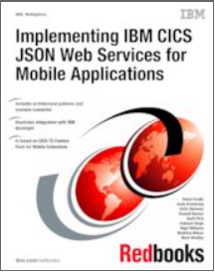
Redbook: Implementing IBM CICS JSON Web Services for Mobile Applications
Table of Contents:
Part 1. Introduction and architecture
Chapter 1. Introduction
Chapter 2. CICS use of mobile technologies
Chapter 3. CICS and IBM Worklight
Chapter 4. Patterns for JSON in CICS
Part 2. Setup and configuration
Chapter 5. Configuring CICS for the example scenarios
Chapter 6. IBM Worklight configuration
Chapter 7. Security and workload management
Chapter 8. Problem determination
Part 3. Application development and scenarios
Chapter 9. Language structure to JSON schema scenario
Chapter 10. JSON schema to language structure scenarios
Chapter 11. Developing a simple JSON web service client application
Chapter 12. IBM Worklight for CICS
Part 4. Appendix
Appendix A. Sample level for a JSON schema
Appendix B. Sample COBOL programs
Appendix C. Additional material
http://www.redbooks.ibm.com/abstracts/sg248161.html

Slide 34
JSON support in CICS TG

Slide 35
REST in Java

Slide 36
REST/JSON in CICS using Java Liberty Server
Liberty Profile Server executes within CICS
Dynamic profile of WAS
Provision only those Java features needed for application
Initially delivered web application server capabilities to CICS
JAX-RS
Java API for RESTful Web Services
Simplifies development and deployment of service clients and endpoints
JSON4J
Set of classes for handling JSON data
Simple model for transforming JSON data to other representations
JAX-RS and JSON4J are well accepted in the Java community

Slide 37
Java in CICS: JAX-RS Example
package com.ddw.sample.json.service; import java.util.HashSet; import java.util.Set; import javax.ws.rs.core.Application; public class SayHelloApplication extends Application { //List the JAX-RS classes that contain annotations public Set<Class<?>> getClasses() { System.out.println("SayHelloApplication: Instaciated"); Set<Class<?>> classes = new HashSet<Class<?>>(); classes.add(com.ddw.sample.json.service.SayHello.class); return classes; } }
package com.ddw.sample.json.service; import javax.ws.rs.GET; import javax.ws.rs.POST; import javax.ws.rs.Path; import javax.ws.rs.core.Response; @Path("/hello") public class SayHello { @GET public String helloGet() { return "{ \"HelloText\", \"Howdy Partner\" }"; } @POST public Response helloPost() { return Response.ok("{ \"HelloText\", \"Hi, Neighbor\" }").status(201).build(); } }

Slide 38
Notes:
This is a very simple JAX-RS program (a hello world).
You can also return a REST response using a regular servlet.
You can use JSON4J to prepare JSON in the REST response.
When using JAX-RS you create both a dispatcher program (on the top) and the program that does the work (on the bottom)

Slide 39
z/OS Connect

Slide 40


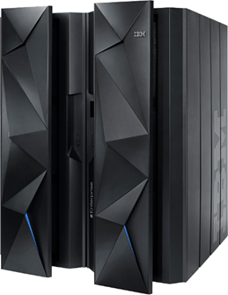


z/OS Connect – what is it?
It’s about getting REST and JSON into your mainframe environment in a way that enables you to best take advantage of the assets that exist there:
Where z/OS Connect fits
CICS
IMS
Mobile Ecosystem
z/OS Connect
DB2
MQ
Task
Liberty Profile Server
Function IBM wrote to run in Liberty Profile
Custom
REST – Representational State Transfer … the use of HTTP URLs that map to a ‘service’, such as ‘query account’ or ‘update data’
JSON – JavaScript Object Notation … a standard of representing data as a set of name/value pairs. This is passed back and forth along with REST request/responses
Notes:
40
We start with a discussion that sets the context for the details that follow.
At the very heart of this discussion is the idea of devices and systems using RESTful calls and JSON data to access the mainframe and the applications and data that resides there. REST and JSON are becoming more and more common in the world of mobile and cloud system access to systems of record. REST and JSON are briefly described here. A more detailed description is offered a bit later in this presentation.
For REST and JSON to be effective, something has to be in place to recognize and handle the REST call and the JSON data.
Key Point: z/OS Connect is designed to be a REST/JSON interface to a z/OS LPAR.
z/OS Connect is software function written by IBM that runs inside an instance of WebSphere Liberty Profile z/OS, and uses existing connector technology to get to the backend systems. There is no charge for z/OS Connect; it is supplied as part of license entitlement to WAS z/OS, CICS or IMS.

Slide 41
Notes
We start with a discussion that sets the context for the details that follow.
z/OS Connect is software function written by IBM that runs inside an instance of WebSphere Liberty Profile z/OS, and uses existing connector technology to get to the backend systems.
At the very heart of this discussion is the idea of devices and systems using RESTful calls and JSON data to access the mainframe and the applications and data that reside there. REST and JSON are becoming more and more common in the world of mobile and cloud system access to systems of record.
For REST and JSON to be effective, something has to be in place to recognize and handle the REST call and the JSON data.
Key Point: z/OS Connect is designed to be a REST/JSON interface to a z/OS LPAR.

Slide 42

z/OS Connect EE High Level Points
Provides a common and consistent entry point for mobile access to one or many backend systems
“Fully REST” enable major z/OS Subsystems
z/OS applications and data appear as any other REST Provider
Support of all REST verbs
No Backend Application Changes
No Coding Required (Tool Driven)
Support of Open Standard Open API Doc (aka Swagger 2.0) for Integration with other products that support the standard
Provide agile (dynamic) API creation, simple testing and easy deployment
Enable “division of duties” between z/OS team and enterprise API team for fast time to deploy
z/OS Connect EE
CICS
IMS
DB2
MQ
WAS
3rd Party
Custom
Notes:
- DB2 needs to enhance tooling integration (known requirement)
- Batch is sometimes listed on this chart – note batch is supported by custom WOLA support and there are no plans to include tooling for batch

Slide 43
Notes
This chart explains the business value of z/OS Connect. The bullet points on the right side of the chart summarize the value proposition of z/OS Connect. At the end of the day it’s about a manageable and simplified interface to the z/OS LPAR for mobile and cloud devices that use REST and JSON.

Slide 44

How Does z/OS Connect EE Work?
4
z/OS Connect Toolkit
z/OS LPAR
Liberty z/OS
1
5
7
REST Clients
z/OS Connect
Backend
(CICS, IMS, DB2, MQ, etc)
REST request/response
6
3
2
1. Liberty z/OS
Liberty z/OS is the Java runtime in which z/OS Connect operates.
2. z/OS Connect EE
This is (essentially) Java code that runs inside the Liberty z/OS server
3. Backend connectivity
Provides access to subsystems
4. API Toolkit
The tooling is what's used to compose Service and the API that operates in z/OS Connect
5. REST clients
These can be anything that understands and supports the RESTful pattern
6. REST requests and responses
The URIs, parameters, and JSON requirements are based on the APIs you compose and deploy
7. Security
Notes:
This is a busy first chart, but it helps set the stage for what this workshop is all about. First and foremost, we wish to make z/OS Connect EE V2.0 understandable, and we start by laying out a physical topology. Physical topologies are often easy to approach because the pieces are well-known things on z/OS such as started tasks, CICS regions, and workstations used for graphical tools.
Follow the numbers on the chart with the notes here:
z/OS Connect EE V2.0 operates inside an instance of Liberty z/OS, which provides the Java runtime environment for z/OS Connect. Liberty z/OS runs as a started task. It has a JCL start procedure associated with it. At this level, z/OS Connect EE V2.0 is fairly standard stuff.
z/OS Connect EE V2.0 is really just IBM-written Java code that runs inside Liberty z/OS. It's fairly sophisticated Java code, but at the end of the day that's what it is: Java code written by IBM that runs in a Liberty z/OS server.
The goal of z/OS Connect EE V2.0 is to take REST requests from clients on the network and turn them into requests that flow into CICS regions or IMS regions. That means there must be a way to communicate between z/OS Connect and CICS or IMS. For CICS, that's WOLA (which we'll talk about more later). For IMS, it's a socket protocol to IMS Connect. In either case the objective is to process a call from Liberty z/OS over into the CICS or IMS region.
The API Editor is used to construct the definition that tells z/OS Connect how to handle the REST requests that come in. The API Editor allows you to design what "paths" (URI patterns) to use, and how you want the REST request information to map to the data requirements of the back end program. Unit 3 is dedicated to this topic.
REST requests come in from REST clients, which may be anything on the network that is capable of forming up a REST request and understanding the response that comes back. For the purpose of this workshop we will remain neutral to what that client is (mobile device, or another mainframe program, or a UNIX process). We remain neutral because ultimately it does not matter what it is. The key is that it can understand the APIs exposed by z/OS Connect EE V2.0, invoke them, and understand the response.
The REST request is what results in the backend program being invoked, the response is what flows back to the client. How the request maps to the backend is what this workshop is all about.
Security … a great big topic which we'll cover to a certain level in the final unit of the workshop.

Slide 45
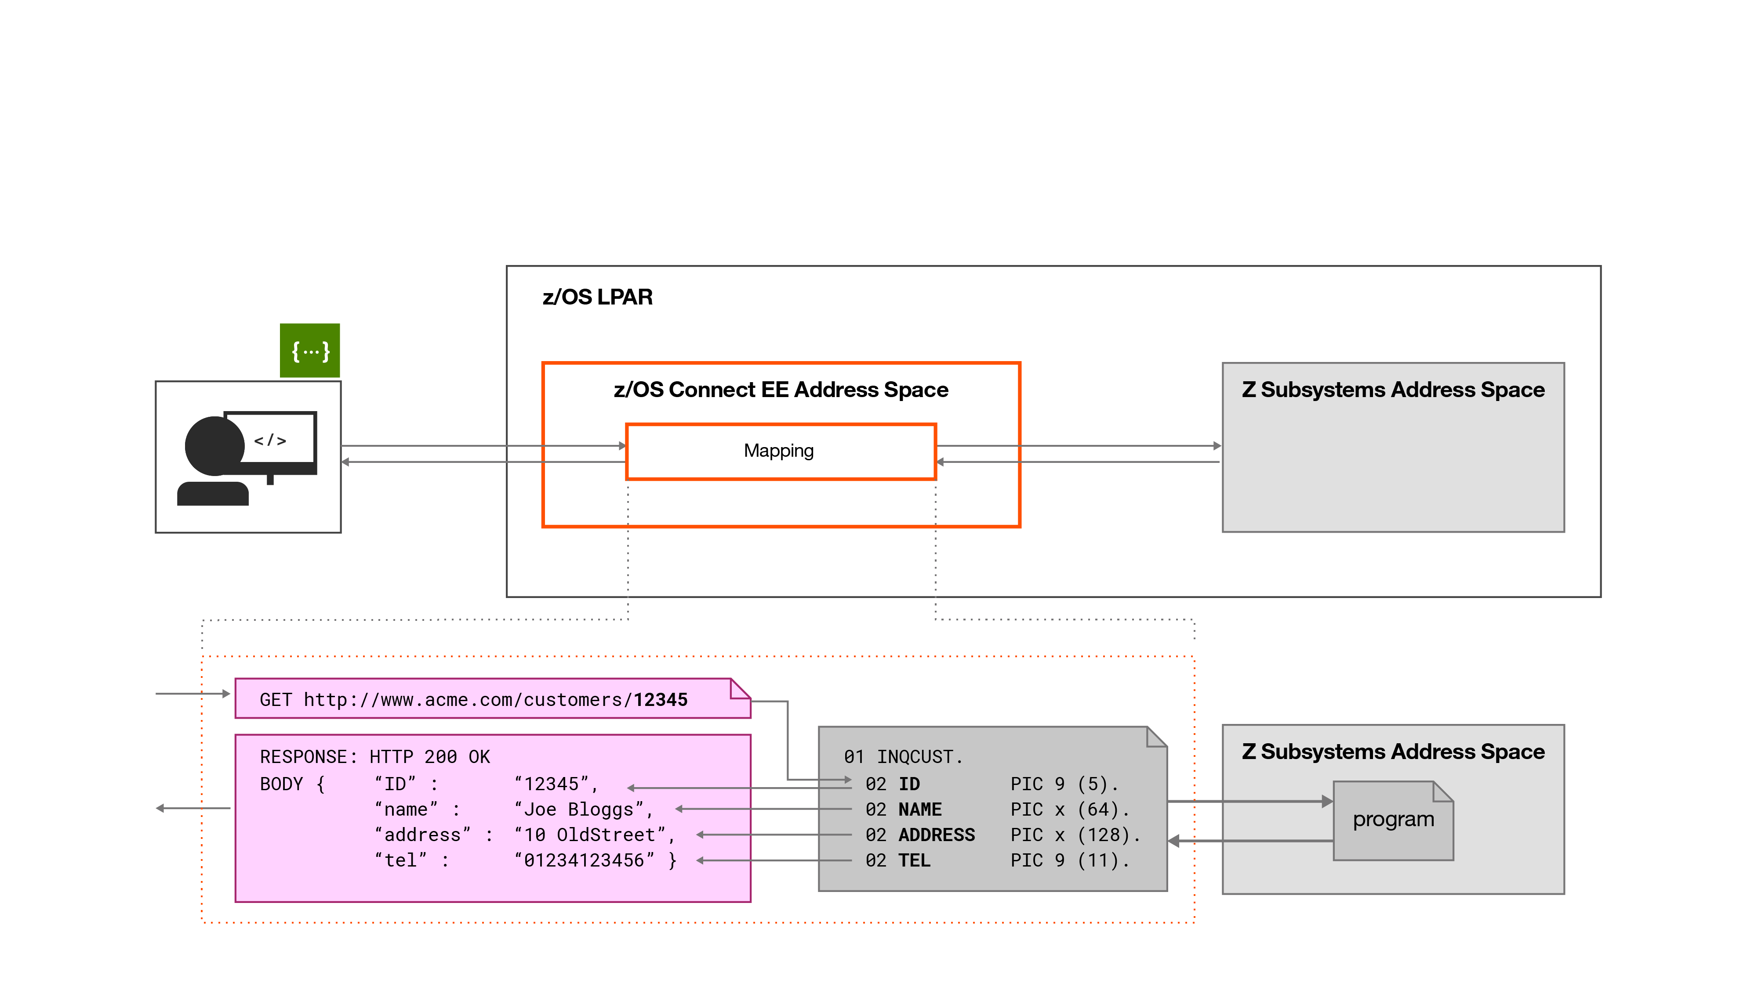
Data mapping - A closer look
Developer friendly APIs
Applications Unchanged
Notes:
This includes mapping path and query parameters. z/OS Connect EE provides granular mapping of data structures, which makes it possible to create genuinely RESTful APIs.

Slide 46
Notes
First and foremost, we wish to make z/OS Connect EE V2.0 understandable, and we start by laying out a physical topology. Physical topologies are often easy to approach because the pieces are well-known things on z/OS such as started tasks, CICS regions, and workstations used for graphical tools.
Follow the numbers on the chart with the notes here:
z/OS Connect EE V2.0 operates inside an instance of Liberty z/OS, which provides the Java runtime environment for z/OS Connect. Liberty z/OS runs as a started task. It has a JCL start procedure associated with it. At this level, z/OS Connect EE V2.0 is fairly standard stuff.
z/OS Connect EE V2.0 is really just IBM-written Java code that runs inside Liberty z/OS. It's fairly sophisticated Java code, but at the end of the day that's what it is: Java code written by IBM that runs in a Liberty z/OS server.
The goal of z/OS Connect EE V2.0 is to take REST requests from clients on the network and turn them into requests that flow into CICS regions or IMS regions. That means there must be a way to communicate between z/OS Connect and CICS or IMS. For CICS, that's WOLA (which we'll talk about more later). For IMS, it's a socket protocol to IMS Connect. In either case the objective is to process a call from Liberty z/OS over into the CICS or IMS region.
The API Editor is used to construct the definition that tells z/OS Connect how to handle the REST requests that come in. The API Editor allows you to design what "paths" (URI patterns) to use, and how you want the REST request information to map to the data requirements of the back end program.
REST requests come in from REST clients, which may be anything on the network that is capable of forming up a REST request and understanding the response that comes back. z/OS Connect is neutral to what that client is (mobile device, or another mainframe program, or a UNIX process). We remain neutral because ultimately it does not matter what it is. The key is that it can understand the APIs exposed by z/OS Connect EE V2.0, invoke them, and understand the response.
The REST request is what results in the backend program being invoked, the response is what flows back to the client. How the request maps to the backend is what this workshop is all about.
Security … a great big topic .

Slide 47
z/OS Connect EE Structure
CICS
Embedded or as started task with WOLA or IPIC
IMS
Via IMS Connect
Service Provider
DB2
Type 2 or 4 JDBC or REST depending on version
REST
z/OS Connect EE
JSON
REST
Such as a WAS z/OS server hosting REST, DB2 or 3rd party
Task
Batch using WOLA APIs to host a service
MQ
Uses JMS – supports 1 way and 2 way messaging
Custom
Sample publicly available on github, 3rd party use
Data
Conversion
Discovery
Function
Audit
Function
Logging
Function
Granular
Authorization

Slide 48
Notes
Note: This chart is designed, in part, to address the question often raised: "I could write my own REST-handling Java code, why should I use z/OS Connect?" The answer is: "Because eventually you'd end up creating a framework like this, and then you'd have a custom framework on your hands you'd have to support. z/OS Connect is a vendor-supported product."
Let's walk through the numbered bullets:
z/OS Connect is built upon the capabilities of Liberty z/OS. That's significant because it allows a great deal of function to be handled by the runtime platform and not handled by z/OS Connect. Perhaps the key element of this is security: the z/OS Connect security model is based in large part on what Liberty z/OS itself provides; to use those security function requires you simply configure the server to make use of what Liberty z/OS provides.
The backend connectivity mechanism requires a linkage from the processing of z/OS Connect to a transport mechanism to the backend system. z/OS Connect uses what's called "service providers" (code to make the transition from z/OS Connect processing to communication call to the backend). For CICS, z/OS Connect uses the cross-memory function called "WebSphere Optimized Local Adapers" (or, WOLA) for that communication. For IMS, the IMS service provider makes use of the IMS Java API to open a socket to IMS Connect, which takes the request and passes it into the IMS region.
Across the bottom of the chart are "interceptors," which you can think of as "exits" to process code for each request received. The interceptors are: Data conversion (converting JSON to backend data format, then back to JSON for the response); Discovery (not really an interceptor for each request, this is a function that provides a way to programmatically query z/OS Connect for information on the configured APIs); Audit, which cuts an SMF 120.11 record for each request; Logging, which logs to file the contents of the request and the response; Authorization, which provides a way to restrict authority once inside z/OS Connect to specific roles.
z/OS Connect provides an extensible interface for both the "service provider" and the "interceptors." That means you could write your own custom components if you wished. The extensive nature of this has been used by both IBM and third-party vendors to extend the functionality of z/OS Connect.

Slide 49


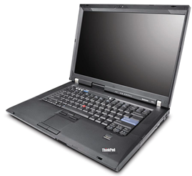
High-Level Overview of z/OS Connect Components
1
Liberty z/OS
Runtime Server
Runs on Liberty z/OS
Hosts APIs you define to run in it
Connects with backend system
Liberty + z/OS Connect = “instance”
You may have multiple instances
z/OS Connect EE Server
Backend Systems (CICS, IMS, DB, etc.)
IBM z/OS 2.1 or higher
IBM 64-bit SDK for z/OS, Java Technology Edition V8.0.0
Eclipse
2
z/OS Connect EE Tooling
Tooling Platform
Integrates with an Eclipse environment
Create Services
Define APIs
Define data mapping
Deploy APIs to runtime server
Export API archive for other tools to deploy
IBM CICS Explorer
IBM IMS Explorer for z/OS
IBM z/OS Connect Toolkit
Notes:
Here’s a high-level of z/OS Connect EE Version 2.0 ... It consists of two primary components:
Runtime server -- this runs on Liberty z/OS, and is where the APIs are hosted. This is the function that receives the REST request and communicates with the backend. A copy of Liberty + z/OS Connect EE V2.0 comprises an “instance,” which is the basis on which z/OS Connect V2.0 is priced.
Note: z/OS Connect EE V2.0 is priced on a “per-instance” basis, with a tier structure that provides lower per-instance pricing the more instances you run. For this overview presentation we will set aside the topic of pricing because it is a conversation best had with the IBM sales representative.
Tooling platform -- this is an Eclipse-plugin that provides the tooling function in support of z/OS Connect EE V2.0. This runs on a workstation platform and is where you define the APIs, define the data mapping, and from which you may deploy the service to the runtime platform.
The minimum requirements for each are shown on the chart.

Slide 50
Notes
Here’s a high-level of z/OS Connect EE Version 2.0 ... It consists of two primary components:
Runtime server -- this runs on Liberty z/OS, and is where the APIs are hosted. This is the function that receives the REST request and communicates with the backend. A copy of Liberty + z/OS Connect EE V2.0 comprises an “instance,” which is the basis on which z/OS Connect V2.0 is priced.
Note: z/OS Connect EE V2.0 is priced on a “per-instance” basis, with a tier structure that provides lower per-instance pricing the more instances you run. For this overview presentation we will set aside the topic of pricing because it is a conversation best had with the IBM sales representative.
Tooling platform -- this is an Eclipse-plugin that provides the tooling function in support of z/OS Connect EE V2.0. This runs on a workstation platform and is where you define the APIs, define the data mapping, and from which you may deploy the service to the runtime platform.
The minimum requirements for each are shown on the chart.

Slide 51
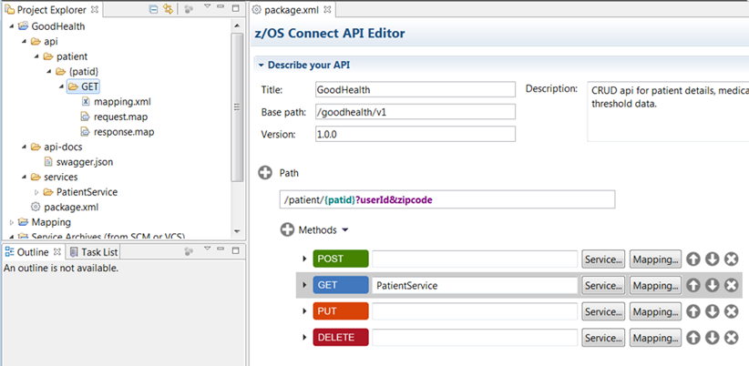
API and Service Creation and Deployment Process
Tooling and Utilities to extract JSON schema from existing applications
* Catalogue COMMAREA structure
03 CA-REQUEST-ID PIC X(6).
03 CA-RETURN-CODE PIC 9(2) DISPLAY.
03 CA-RESPONSE-MESSAGE PIC X(79).
* Fields used in Inquire Single
03 CA-INQUIRE-SINGLE.
05 CA-ITEM-REF-REQ PIC 9(4) DISPLAY.
05 FILLER PIC 9(4) DISPLAY.
05 FILLER PIC 9(3) DISPLAY.
05 CA-SINGLE-ITEM.
07 CA-SNGL-ITEM-REF PIC 9(4) DISPLAY.
07 CA-SNGL-DESCRIPTION PIC X(40).
07 CA-SNGL-DEPARTMENT PIC 9(3) DISPLAY.
07 CA-SNGL-COST PIC X(6).
07 IN-SNGL-STOCK PIC 9(4) DISPLAY.
07 ON-SNGL-ORDER PIC 9(3) DISPLAY.
Backend Program
Source of copy book and target of invocation
API Editor
Dynamic API and Services Deployment
API Definition
Services Definition
zCEE Server Runtime
API and Services Creation

Slide 52
Notes
This chart is meant to provide a little background on the story of z/OS Connect and the transition to z/OS Connect EE V2.0.
The story starts in the second half of 2014 when z/OS Connect V1.0 was released. It was released as a "feature" to Liberty z/OS, not a separate product, and the license entitlement that allowed you to receive z/OS Connect V1.0 was provided under either WAS z/OS, CICS, IMS or (not until 4Q2015) DB2. The license terms and conditions were slightly different for each, and so too was the operational characteristics of z/OS Connect under each license entitlement. It was a somewhat confusing picture. z/OS Connect V1.0 was enhanced in the second half of 2015 with a few items.
At that time IBM decided to turn z/OS Connect into a separate product, and from that came z/OS Connect Enterprise Edition V2.0, which was released in December of 2015. It provided the functional enhancements as shown on the chart:
Separately licensed – this eliminates the confusion created by the separate license entitlement of V1.0. It provides for a more consistent delivery model.
Better REST implementation – V1.0 was a somewhat coarse-grained service invocation model, with little exploitation of HTTP verbs and no access to query parameters. V2.0 fixes that.
Consistent tooling – V1.0 had tooling that went from "pretty good" (IMS) to "non-existent". With V2.0 there is an API Editor that is consistent across platforms.
APIs as deployable units – V2.0 creates an API layer separate from the underlying service layer (details on that coming up) which allows the API (what the clients interface with) be a deployable artifact (an "API Archive," or AAR file). This allows for more discrete deployments of APIs as well as a point of source control for API definitions.
Swagger 2.0 support – this moves z/OS Connect into the realm of compatibility with more and more functions that understand the emerging Swagger standard for documenting and exchanging information about the API definition.
z/OS Connect V1.0 is functional stabilized (except for those items included in IBM's statement of direction). V1.0 is what it is at this point in time, with the development energy going to z/OS Connnect EE V2.0 into the future.

Slide 53
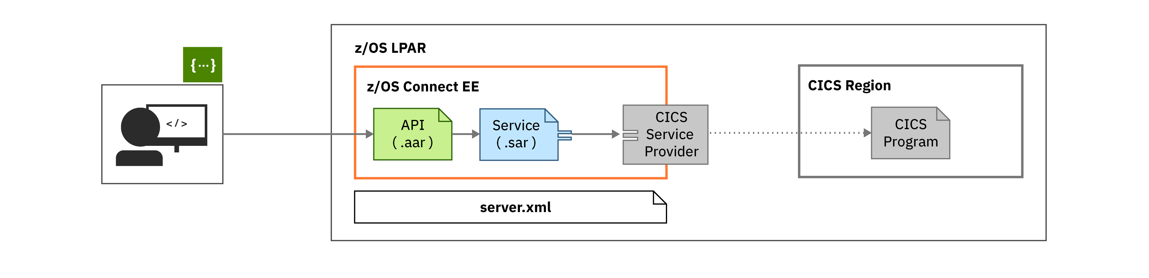

Connect to CICS
API provider: Liberty z/OS Connect on z/OS
Data transform: WSBind files
CICS integration: IPIC
Connection to CICS is configured in server.xml.
An IPIC connection must be configured in CICS.
Transformation of data from JSON to copybook layout and mapping of the REST semantics to the program linkage takes place within the z/OS Connect server and the target CICS programs are invoked via a LINK/DPL, receiving data in a Commarea or Containers.
ibm.biz/zosconnect-scenarios

Slide 54







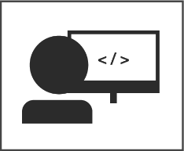




API Documentation via Open API Doc (aka swagger)
z/OS Connect EE tooling produces Open API Doc for defined z/OS APIs
/api1
CICS
/api2
IMS
/api1
DB2
/api2
/api3
/api3
MQ
APIs are discoverable from z/OS Connect EE
/zosconnect/apis
…
URIs of Open API docs can be consumed by other products that support the standard such as API management products from IBM (API Connect)
Notes:
z/OS Connect EE serves up Swagger documents for each API it exposes, creating a single endpoint for discovery.
swagger.json is also available in the API Editor projects.

Slide 55
Which way to go?

Slide 56
REST which way to go ?
z/OS Connect
Fast on-ramp to z/OS applications (IMS, CICS, etc)
Common interface
Tools to allow developer to define secure REST service without the need to develop extensive code for System z
JSON programs in CICS
REST service in CICS using the CICS API or PIPELINE
No automatic client support with JSON, although you can use the CICS WEB API and the DFHJSON program (or EXEC CICS TRANSFORM)
Java program
Lots of Java programmers
Java standards
Skill set
Many people use what they know
Notes:
Notes:
Instructor notes:
Purpose — List the topic objectives
Details —
Additional information —
Transition statement —

Slide 57
Notes:
This slide proposes a few reason why you may want to using one environment over the other.

Slide 58
Summary
REST
What is it used for
Its origin
Details
HTTP, the flows
JSON
Origin
Layout and specification
CICS native JSON support
z/OS Connect

Slide 59
References for JSON and REST
Articles and tutorials:
https://www.youtube.com/watch?v=Sqtlm1jxpBI&feature=c4-overview-vl&list=PLJxIWNrnCsg-oAben8EgVEF4a9FlRdNBa
https://www.youtube.com/watch?v=6TkQ9PzeevQ&list=PLJxIWNrnCsg-oAben8EgVEF4a9FlRdNBa&index=4
https://www.youtube.com/watch?v=SqjlXxw2FiY&list=PLJxIWNrnCsg-oAben8EgVEF4a9FlRdNBa&index=1
https://www.youtube.com/watch?v=5JyJ0XXR_3c&index=2&list=PLJxIWNrnCsg-oAben8EgVEF4a9FlRdNBa
Notes:
Notes:
Instructor notes:
Purpose — List the topic objectives
Details —
Additional information —
Transition statement —

Slide 60
References for JSON and REST
Roy Fielding’s Doctoral Thesis – for the definition of REST – http://en.wikipedia.org/wiki/Roy_Fielding http://www.ics.uci.edu/~fielding/pubs/dissertation/top.htm
SG24-8161 – Implementing CICS JSON Web Services for Mobile Applications http://www.redbooks.ibm.com/abstracts/sg248161.html
JSON RFC 4627 – http://www.ietf.org/rfc/rfc4627.txt
JSON – the basics – http://www.ibm.com/developerworks/webservices/library/ws-restful/
Notes:
Notes:
Instructor notes:
Purpose — List the topic objectives
Details —
Additional information —
Transition statement —

